Slide 1
Assignment #3 An Exercise of SQL Using SQL*Plus
KAIST
Myoung Ho Kim

Slide 2
Table of Contents
SQL*Plus Commands
Assignment #3
SQL Queries

Slide 3
SQL*Plus Commands

Slide 4
SQL*Plus Commands
SELECT * FROM tab;
list all the tables stored in the database
TAB | Attribute Name | Type
 | TName | VARCHAR2(30)
 | TabType | VARCHAR2(7)
 | ClusterID | NUMBER
SQL> create table TEST (
2 name char(10));
Table created.
SQL> create table TEST2 (
2 name char(10));
Table created.
SQL> create table TEST3 (
2 name char(10));
Table created.
SQL> select tname from tab;
TNAME
------------------------------------------------
TEST
TEST2
TEST3
3 rows selected.

Slide 5
SQL*Plus Commands (cont’d)
DESC <table_name>
shows information of a table <table_name>
SQL>create table STUDENT (
2 studentId NUMBER PRIMARY KEY,
3 name VARCHAR2(10),
4 department VARCHAR2(25),
5 semesters NUMBER,
6 doubleMajor VARCHAR2(25));
Table created.
SQL> DESC STUDENT;
Name Null? Type
----------------------------- ---------------- ---------------
STUDENTID NOT NULL NUMBER
NAME VARCHAR(10)
DEPARTMENT VARCHAR(25)
SEMESTER NUMBER
DOUBLEMAJOR VARCHAR(25)

Slide 6
SQL*Plus Commands (cont’d)
Transaction commands
ROLLBACK
Undo changes (transactional).
COMMIT
Save changes in database (transactional).
SET AUOTOCOMMIT ON
commit pending changes to the database after Oracle Database executes each successful INSERT, UPDATE.
SET AUTOCOMMIT OFF
suppress automatic committing so that you must commit changes manually.

Slide 7
SQL*Plus Commands (cont’d)
Transaction commands
rollback;
SQL>insert into dept values(50, ‘AD’, ‘SEOUL’);
1 row created.
SQL>select * from dept;
DEPTNO DNAME LOC
------------ -------------------- ---------------
30 SALES CHICAGO
40 OPERATIONS BOSTON
50 AD SEOUL
SQL> rollback;
SQL>select * from dept;
DEPTNO DNAME LOC
------------ -------------------- ---------------
30 SALES CHICAGO
40 OPERATIONS BOSTON
Undo work done

Slide 8
SQL*Plus Commands (cont’d)
Transaction commands
commit;
SQL> commit;
Commit complete.
SQL>select * from dept;
DEPTNO DNAME LOC
------------ -------------------- ---------------
30 SALES CHICAGO
40 OPERATIONS BOSTON
50 AD SEOUL
SQL> rollback;
Rollback complete.
SQL>select * from dept;
SQL>insert into dept values(50, ‘AD’, ‘SEOUL’);
1 row created.
SQL>select * from dept;
DEPTNO DNAME LOC
------------ -------------------- ---------------
30 SALES CHICAGO
40 OPERATIONS BOSTON
50 AD SEOUL
Save changes
DEPTNO DNAME LOC
------------ -------------------- ---------------
30 SALES CHICAGO
40 OPERATIONS BOSTON
50 AD SEOUL

Slide 9

Outerjoin Syntax
Right outer join
MovieStar NATURAL RIGHT OUTER JOIN MovieExec;
MovieStar
MovieExec
name | address | gender | birthdate
Mary T. Moore Tom Hanks | Maple St. Cherry Ln. | ‘F’ ‘M’ | 9/9/99 8/8/88
name | address | cert# | networth
Mary T. Moore George Lucas | Maple St. Oak Rd. | 12345 23456 | $100… $200…
Result
name | address | gender | birthdate | cert# | networth
Mary T. Moore George Lucas | Maple St. Oak Rd. | ‘F’ NULL | 9/9/99 NULL | 12345 23456 | $100… $200…

Slide 10
Outerjoin Syntax (cont’d)
MovieStar NATURAL RIGHT OUTER JOIN MovieExec;
1.
SELECT *
FROM MovieStar NATURAL RIGHT OUTER JOIN MovieExec
SELECT *
FROM MovieStar star RIGHT OUTER JOIN MovieExec exec
ON star.name = exec.name AND
star.address = exec.address;
2.
SELECT *
FROM MovieStar star, MovieExec exec
WHERE star.name(+) = exec.name AND
star.address(+) = exec.address;
3.

Slide 11
Assignment #3

Slide 12
Submission
Due
Sep. 30, 2:00 a.m.
Delay is not accepted
Submission standard (same as HW #2)
[student ID].lst contains the executions of SQL commands and their results. You may use SPOOL command.
Upload the .lst file to course homepage
Evaluation
You will get points if your SQL queries find the right answers.
Do not cheat others. Both of them will get no point.
Contacts of this HW #3
Email : cmryu@dbserver.kaist.ac.kr (Chungmo Ryu)
Office Hour : Wed. 16:00 ~ 17:30, Fri. 14:30 ~ 16:00 (N1, 404)

Slide 13
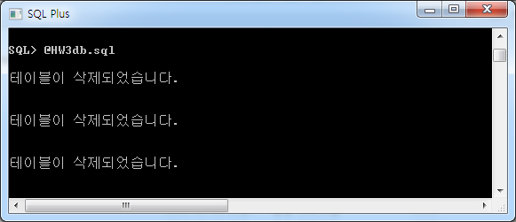
Example Database
Create tables for homework.
Download HW3db.sql from the course homepage and Copy it to (directory that Oracle Client is installed)\BIN
@HW3db.sql or start HW3db.sql
(* its contents are same as HW2db.sql from HW #2)

Slide 14
Example Database (cont’d)
Database Design
You can see all the tables stored in your database using a command ‘select * from tab;’
PRODUCT | maker | model | type
 | A | 2001 | pc
 | A | 1002 | pc
 | …
PC | model | speed | ram | hd | price
 | 1001 | 2.66 | 1024 | 250 | 2114
 | 1002 | 2.10 | 512 | 250 | 995
 | …
PRINTER | model | color | type | price
 | 3001 | true | Ink-jet | 99
 | 3002 | false | laser | 239
 | …
LAPTOP | model | speed | ram | hd | screen | price
 | 2001 | 2.00 | 2048 | 240 | 20.1 | 3673
 | 2002 | 1.73 | 1024 | 80 | 17.0 | 949
 | …

Slide 15
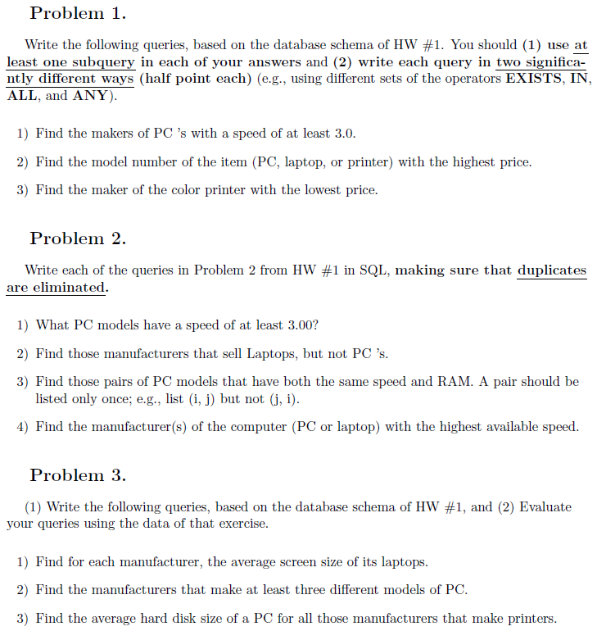
Queries

Slide 16
Queries

Slide 17
Queries

Slide 18
References
Lecture notes
Text book
Chapter 6.3, 6.4
Oracle SQL Plus Tutorial
http://www.holowczak.com/oracle/sqlplus/

